Slide 1
CYBR 493A
Introduction
Lecture 1.B. : Python installation and configuration

Slide 2
TOPICS
Python configurations:
Installation (Miniconda)
Install IDE
Install Jupyter
Link all the above to git repository
Testing, testing, and more testing.

Slide 3
Why “install” python
Remember that Operating Systems do not understand programming languages
If you wish to use a programming language, you will need to install a program to allow the OS to debug and compile your code
When we say we need to install python, we mean we need to install an interpreter that translates code to something makes sense to your OS

Slide 4
What do you need to run python?
Python interpreter
A place where you can write and debug your cod, known as Integrated Development Environment (IDE). We will use PyCharm.
Note: you can install Jupyter to code and execute your code, one line at a time. We will also need this for this class.
Lastly, we will need a way to connect those to our git repository.

Slide 5
Check whether you have Python
Before we dive into the installation process, check whether your OS has python or not.
For Windows users: go to run =>type cmd=>type python -v.
For Mac users: open the terminal application and type python -v

Slide 6
Python installation
There are different ways to install python:
Get it from the app store: easy and straightforward however, it is painful to have different python versions.
Use Anaconda (or Miniconda): free open-source distribution of Python and R: Needs some knowledge however, it allows using different versions. We will use this in this class.

Slide 7
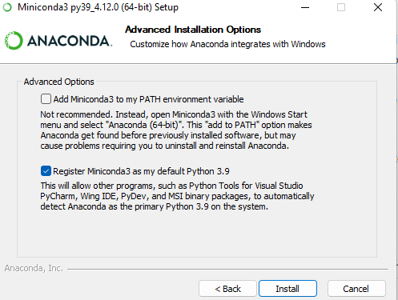
Miniconda Installation 1/2
Access the miniconda website, download and install miniconda.
In advanced options, choose “Register Miniconda3 as my default Python 3.9.

Slide 8
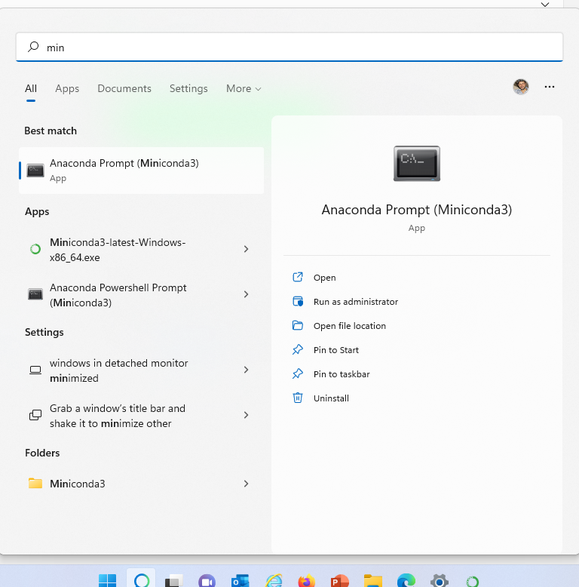
Miniconda Installation 1/2
Now that you have Miniconda installed, you should be able to see the Anaconda prompt (terminal). Go ahead and start the prompt => run as administrator

Slide 9
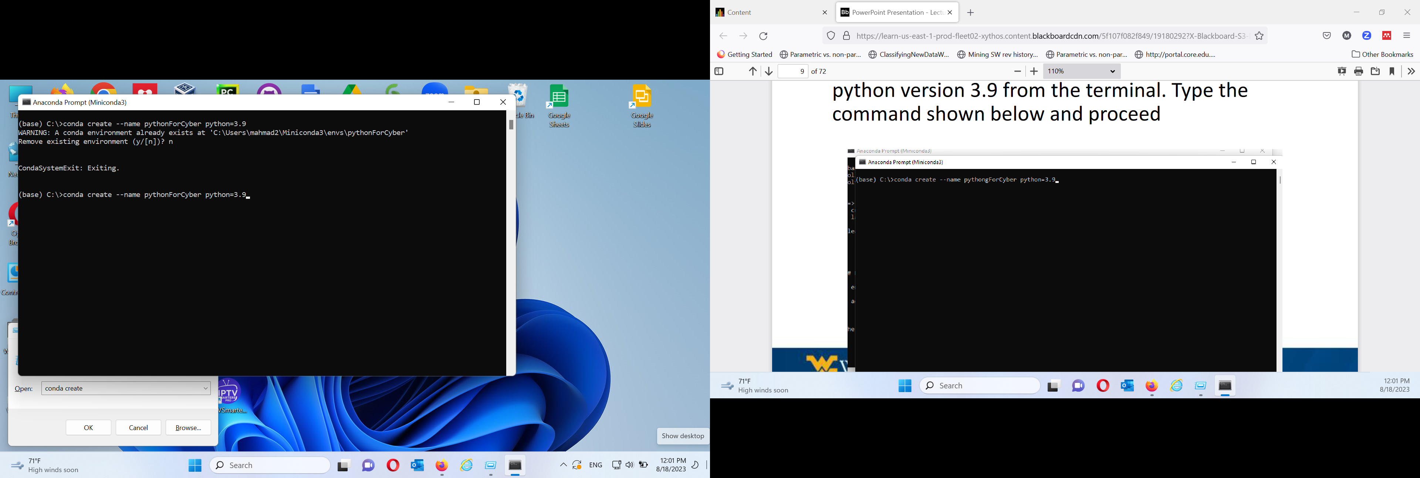
Miniconda Environment for Python 1/2
Now we need to create a new environment for python version 3.9 from the terminal. Type the command shown below and proceed

Slide 10
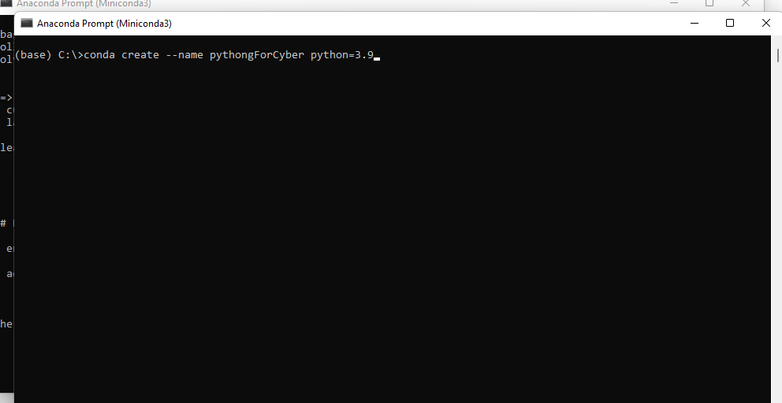
Miniconda Environment for Python 2/2
You may create other environments if you wish to use different versions of python. Just change the version number to 3.6 for example if you wish to use that version.

Slide 11
Jupyter
Jupyter is a web-based interactive development environment for notebooks, code, and data
Its flexible interface allows users to configure and arrange workflows in data science, scientific computing, computational journalism, and machine learning.
A modular design invites extensions to expand and enrich functionality.
We can run our code one line at a time instead or running the whole program

Slide 12
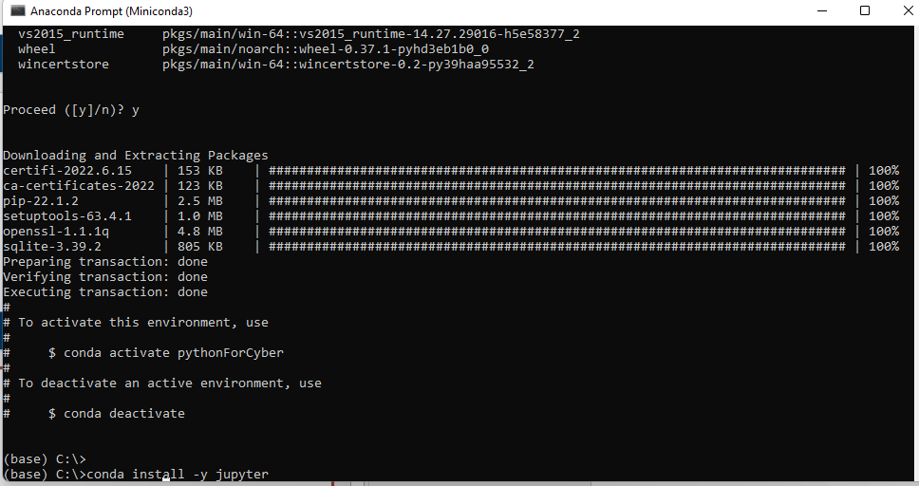
Install Jupyter
The easiest way to install jupyter is using the miniconda terminal.
While the terminal is open, type the command below:

Slide 13
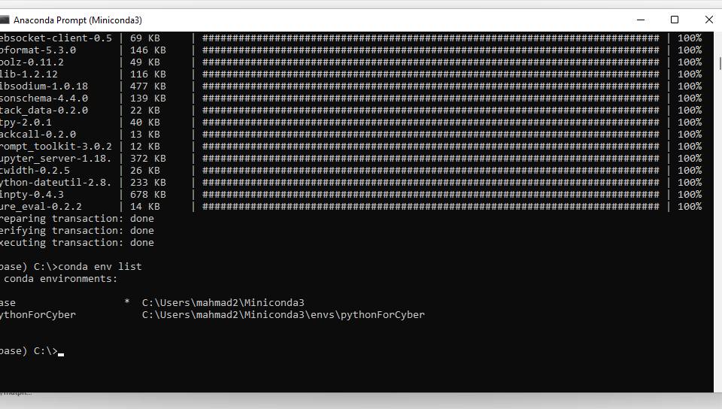
View miniconda environments
Since we may have more than one python environment, we need to specifically tell miniconda which one we would like to use
Let us view all the current environments first, use the command below. Notice there are two.

Slide 14
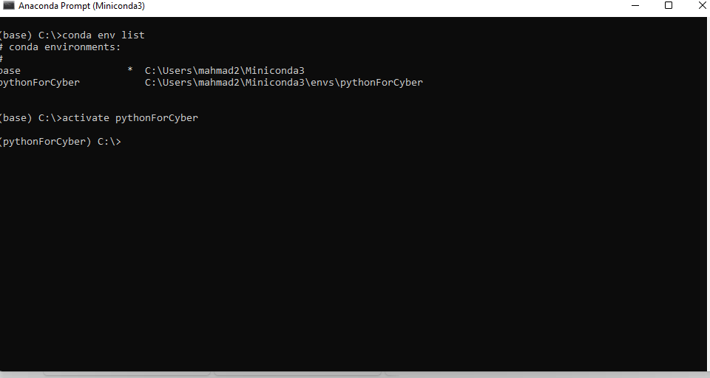
Activate miniconda environment
You need to ensure that you use the correct environment every time you code.
You will need to activate the environment you created earlier (every time you want to use Jupyter). Use the command below

Slide 15
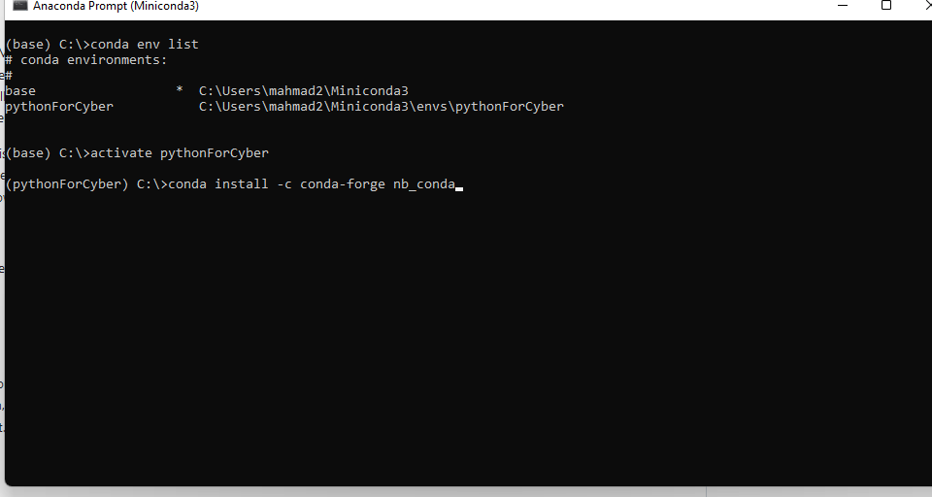
Add support to jupyter
Run the command below to add support for Jupyter, make sure you are in the correct environment

Slide 16
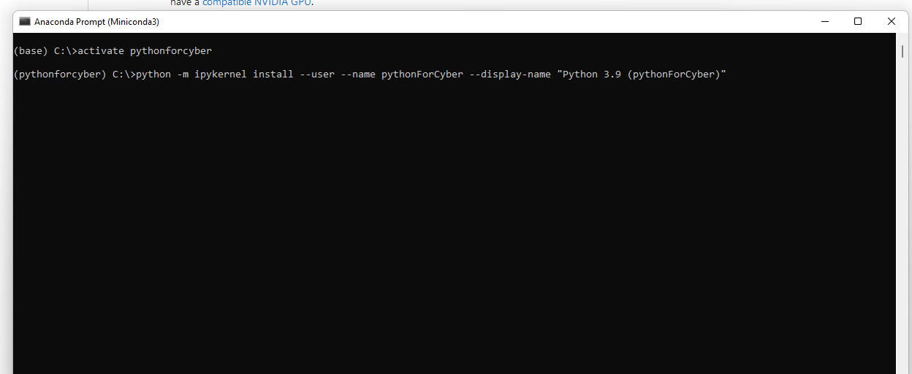
Register jupyter
Last thing, we need to register the environment to be accessible
Run the command:

Slide 17
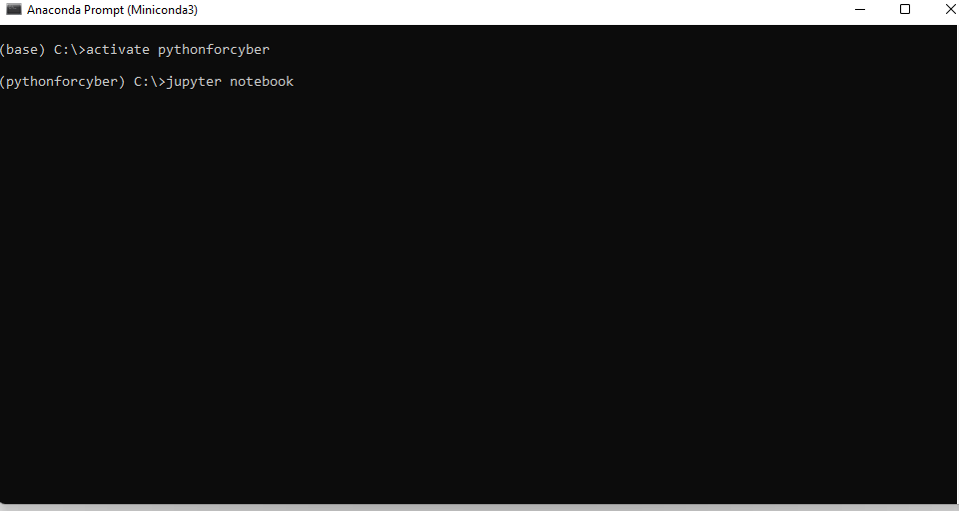
Start Jupyter
The easiest way to start jupyter is by providing the command below, in the terminal. A new web page should open. Do not close the terminal window, keep open as long as you are using jupyter.

Slide 18
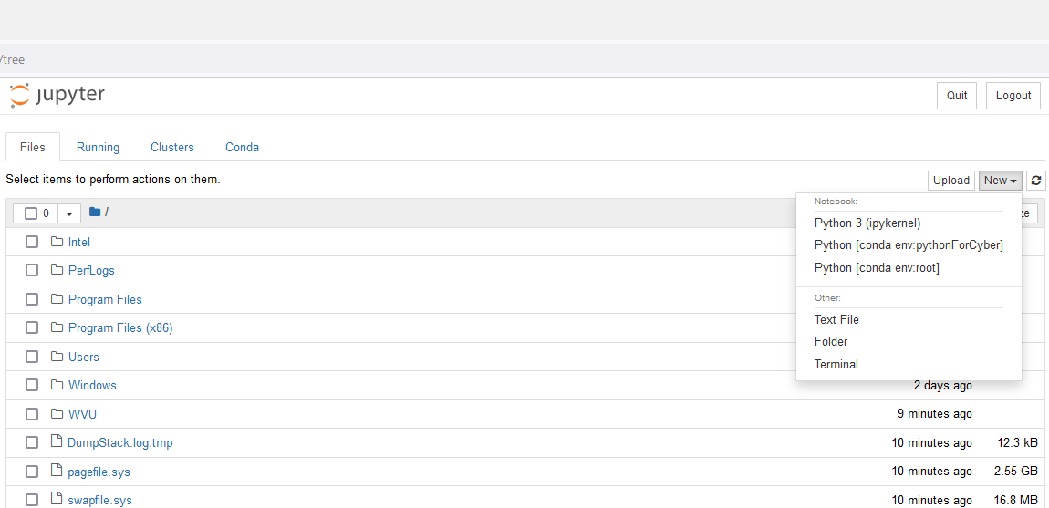
Jupyter
Once jupyter starts, create a new notebook and select the right python (pythonForCyber)

Slide 19
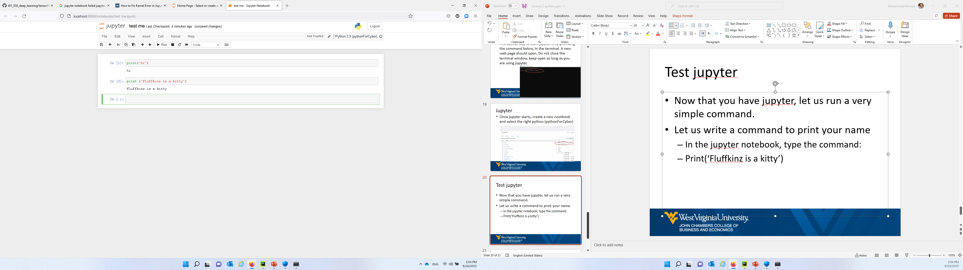
Test jupyter
Now that you have jupyter, let us run a very simple command.
Let us write a command to print your name
In the jupyter notebook, type the command:
Print(‘Fluffkinz is a kitty’)
Jupyter is ready to go ☺

Slide 20
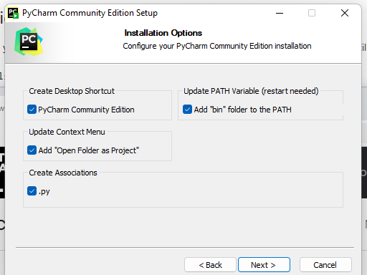
PyCharm IDE
Download and install PyCharm IDE (community version) from the PyCharm website
Check the following

Slide 21
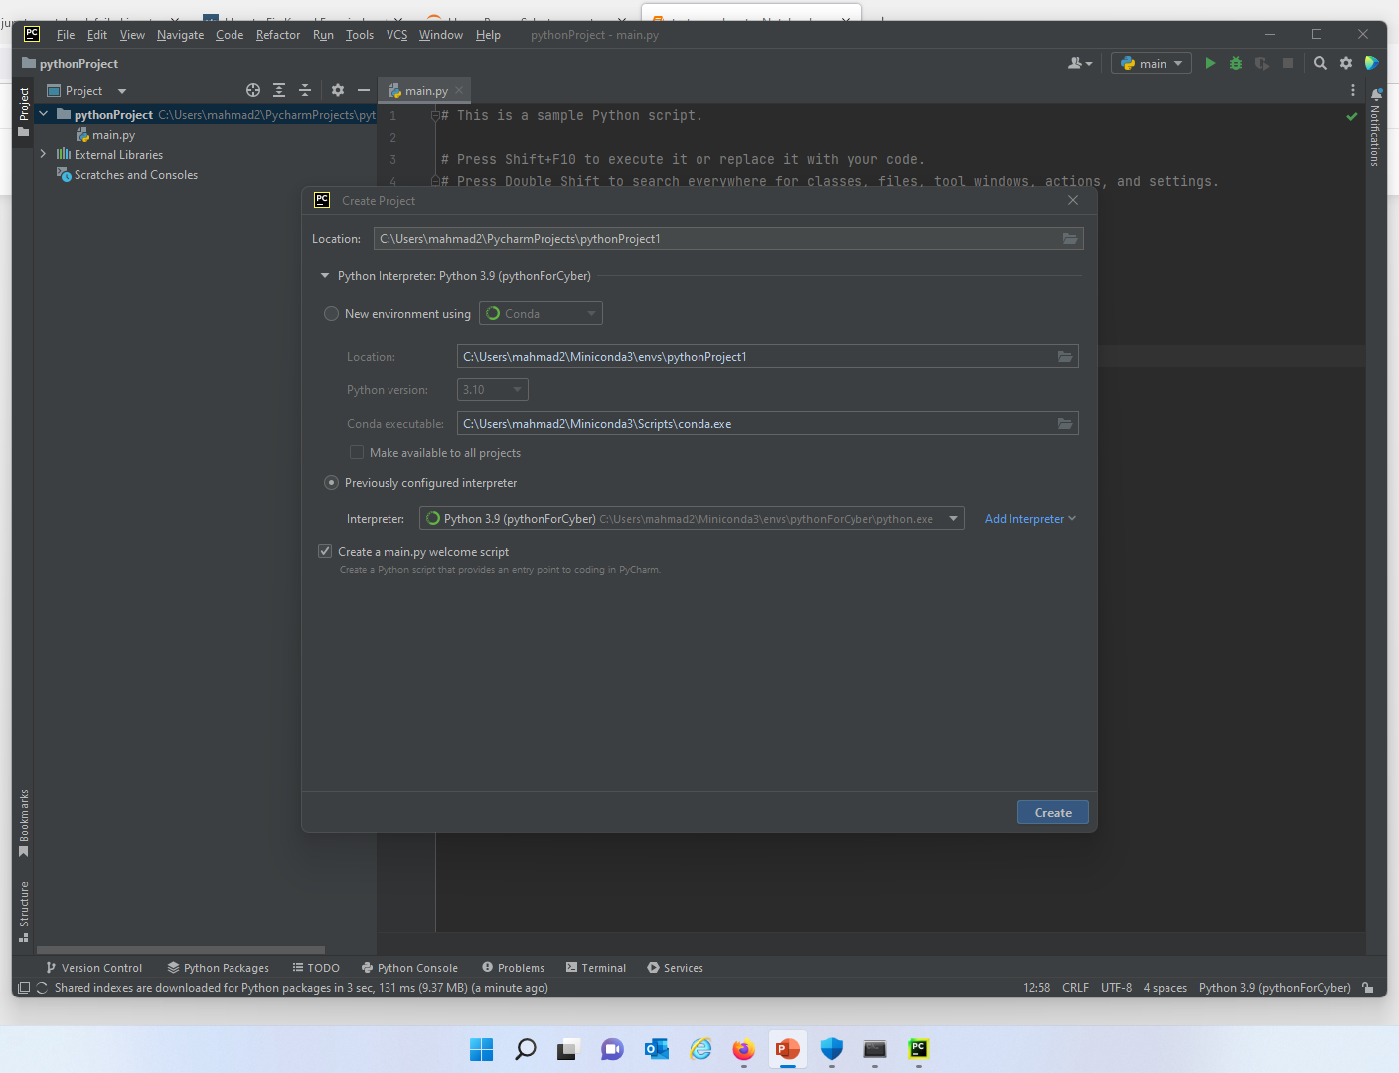
PyCharm: a new python project
PyCharm needs to know which python interpreter to use.
Click on new project and select the options as shown below.

Slide 22
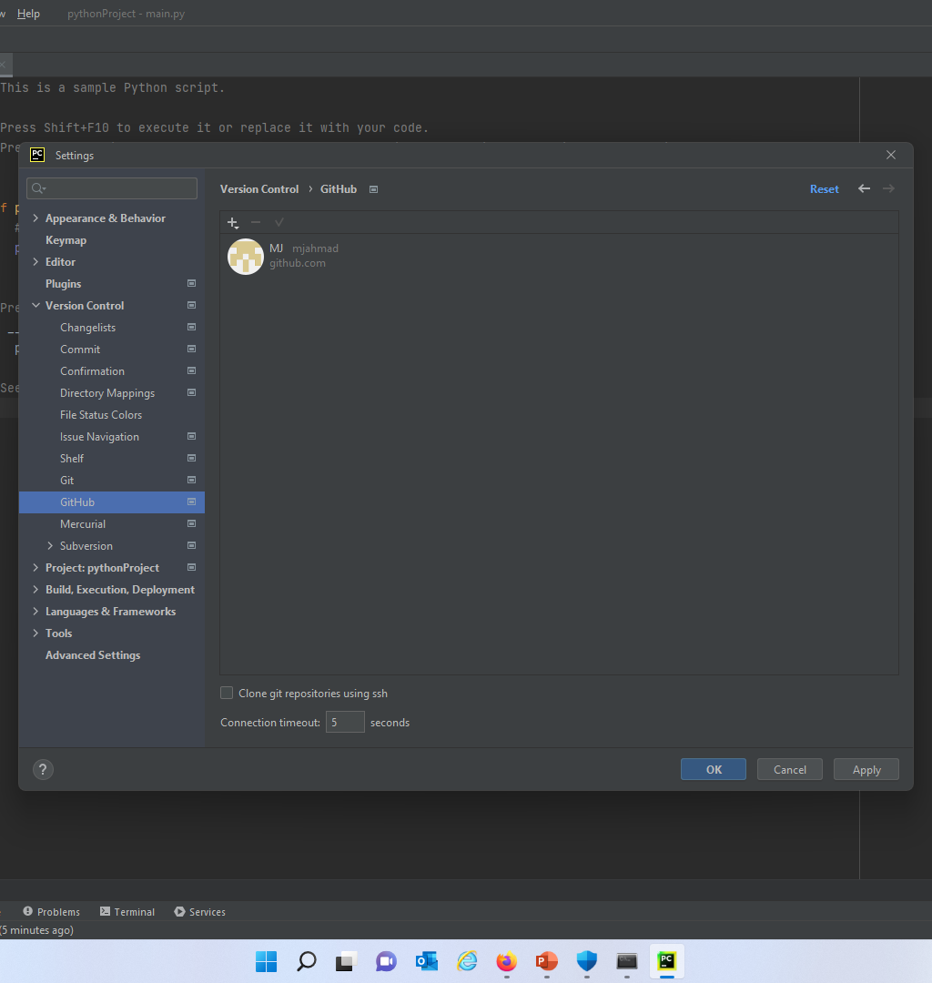
Connect PyCharm to git
Access the settings screen and login to your account

Slide 23
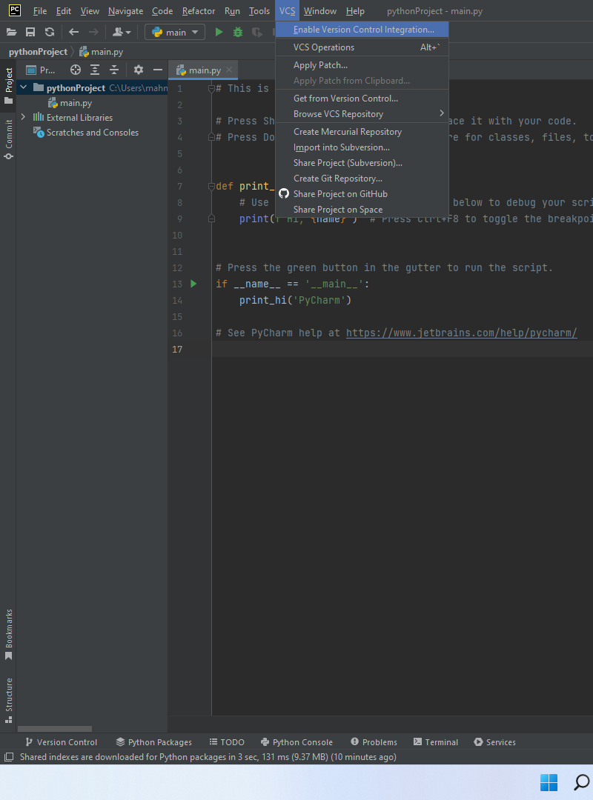
Enable git with PyCharm

Slide 24
Python projects
A project may have several python files
Right click and add new python file.
To ensure your python is configured correctly, copy and past the code and run.
Try opening the start or end folder from the cloned PythonForCyber git repo.

Slide 25
Let us add a Database Management System (DBMS) to our systems
DBMS are essential to manage and control databases.
While this class is not a DB class however, we will get into SQL injection
We will most likely need a DBMS to do that.
There are many DBMS offered for free
For this class, we will get PostgreSQL

Slide 26
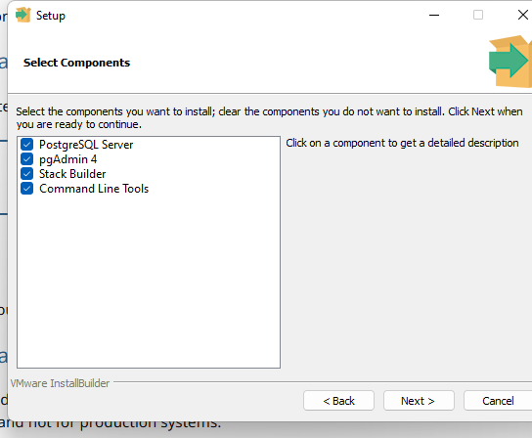
PostgreSQL: Download and installation
You may download PostgreSQL for free from the PostgreSQL website.
You may check all options but the minimum is PostgreSQL server and pgAdmin 4.

Slide 27
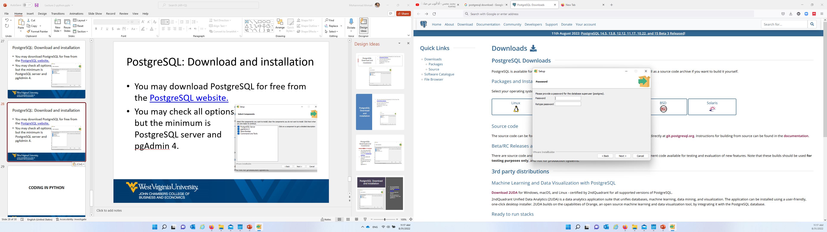
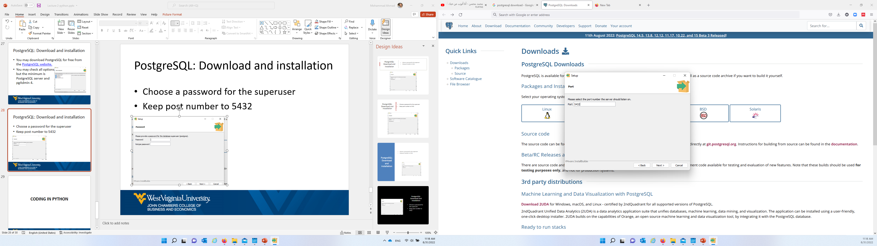
PostgreSQL: Download and installation
Choose a password for the superuser
Keep post number to 5432

Slide 28
Use PostgreSQL
In order to access PostgreSQL, you will need to use its designated tool named pgAdmin.
You will be asked to setup another password, please use the same password you used for the superuser. This will make your life easier ☺.

Slide 29
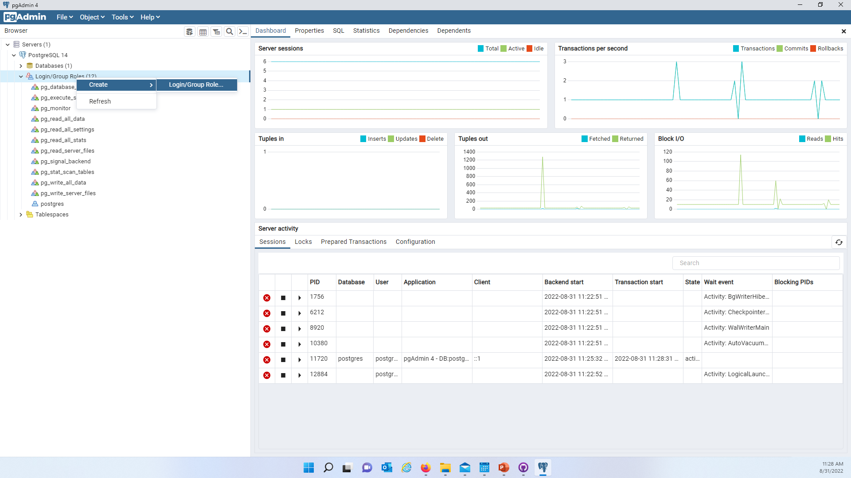
Create a separate user for CYBR 493
Let us create a new user for this class with a unified password.
Launch pgAdmin
Login/ Group Roles
Right click and create login/ Group Role

Slide 30
CYBR 493 DB user details
Use the following details for the new user:
Name: cyberUser (case sensitive)
Password: c-4-9-3-A (case sensitive)
Privileges: Check all
And now save.

Slide 31
Create new DB for CYBR class
Under Databases:
Create a new database named cybrDB (case sensitive)
Owner: choose cybrUser

Slide 32
Coding in python

Slide 33
Where to start?
You may use Jupyter or PyCharm to code in python.
Jupyter: allows for line-by-line execution
PyCharm: runs the entire program at once.

Slide 34
Using libraries/ packages
We will be using packages when using python.
To use a package, you need to do two things:
Install it to your python environment
Import it in your python file.

Slide 35
Installing libraries/ packages
The easiest way to install a package is to do so using Anaconda command prompt.
Navigate to your Anaconda terminal
Activate your pythonForCyber
And use the command :
pip install [package name]
OR
conda pip install [package name]

Slide 36
Test python- PostgreSQL connection
Delete the older repo named CYBR490A_Repo.
Clone the new repo named CYBR490_Repo
You have already received an invitation.
Open the project in PyCharm.
DBTester.py should create a new table
You will need to install the package named psycopg2 before running the DBTester.py

Slide 37
Coding in python CH2: python for cybersecurity

Slide 38
Pseudo code
Plain language description of steps in an algorithm/ program.
It is highly encouraged to use it before programming.
Makes programming easier and shows issues in your logic (if there were any).

Slide 39
Pseudo code: Example
Let us say we need to write a program that accepts two values from the user then sums those values.
What would be the first step?
What would be the second step?
See next slide

Slide 40
Pseudo code: Example
Begin
define variable 1 and variable 2
Display a message: ask users for variable 1 value
Input variable1
Display a message: ask users for variable 2 value
Input variable2
display (variable 1 + variable 2)
End

Slide 41
Pseudo code: Implementation
Update your current CYBR490_Repo to obtain the file named Sum.py.
Take a look at the code, do you see anything weird?
Can we fix it?

Slide 42
Variables
The term variables refers to something that can change. Even if you are not familiar with the idea of a variable, if you took algebra or trigonometry in school, you have used variables in the past.
You would have seen them written similarly to x = 3 + 5 , followed by the request Find the value of x.

Slide 43
Variables
The easiest way to describe a variable in a computer is to imagine a box. We can take a box and give it a name such as “Frank”.
We then can put almost anything we want, such as marbles, into “Frank”. Then, instead of asking for the specific contents (i.e., the marbles we put in it), we can ask for “Frank” instead

Slide 44
Working with Variables
Working with variables in Python is mostly simple; there are more complex variable types seen later will make it more difficult, but these are generally based on simple types.
We start with a name, such as color, and then assign a value to it using a single equal sign ( = ).
When a single equal sign is used in Python, it assigns the value on the right of the equal sign to the variable on the left. For instance, if we were painting a car, we might assign color = "Yellow"

Slide 45
Variable Names
When working with Python, there several conventions, or suggestions, on how to name variables. These conventions help to encourage the “readability” focus when working with Python. More information regarding conventions can be found in the Python Style Guide .

Slide 46
Variable Names: Make names meaningful
Variable names should be descriptive of what information, or type of information, they hold.
For instance, names such as student_id, first_name, and vehicle_type help identify the content of the variable and where it would be used.
Names such as x, spam, and eggs are not descriptive and can become confusing, especially if reused multiplied times in a script. Names should be lowercase

Slide 47
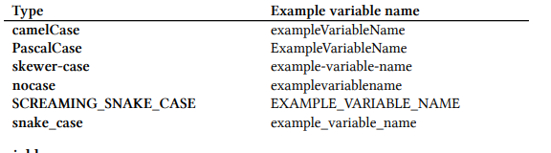
Variable Names: Names should be lowercase
Wherever possible, Python variable should be all lower case. Different programmers have preferred variable naming styles such as camelCase, PascalCase, skewer-case, nocase, and even SCREAMING_SNAKE_CASE. Python suggests using what is known as snake_case, all lower-case letters with underscores separating words

Slide 48
Variable Types
Just as there are different types of pets in people’s homes, there are different types of variables in Python. It is important to recognize the different types of variables because some types work well together, while other types need special consideration to work together.
We can see more information about what our variable type is by using the type() built-in Python function.
We can see an example of this below.
String (str) - can be a combination of text, numbers, and spaces, or most anything you can type on the keyboard.
Integer (int) - is a simple number that doesn’t include a period. Numbers such as 0, 1, 2, -5, and 42 are integers.
Float (float) - is a number that includes a period. Numbers such as 3.14 and 1.234 are floats.

Slide 49
Conditional statements
One of the most useful operations in programming is if statements.
Simply, you are testing whether a condition is true or false and act accordingly.
In your own repositor, create a new python file named IfStatementExample and provide the code in the next slide:

Slide 50
Conditional statements: Example
One of the most useful operations in programming is if statements.
Simply, you are testing whether a condition is true or false and act accordingly.
In your own repository, create a new python file named IfStatementExample and provide the code in the next slide:

Slide 51
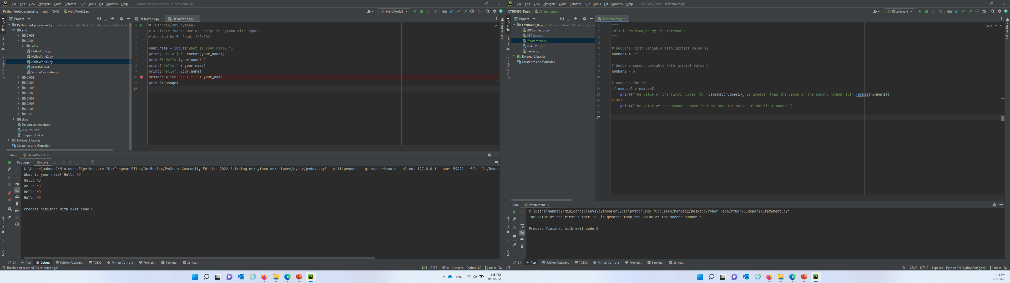
Conditional statements: Example

Slide 52
Please refer to CH2 codes in the pythonforcybersecurity repo for examples

Slide 53
Debugging code
It is preferable to Debug your code before running. This will allow you to do two main things:
Keep track of variables and their values
Spot errors as they occur
Let us debug HelloWorld3.py:
Notice the variables names as they change
We can add breakpoints as well.

Slide 54
Simple Calculator
Let us create a simple calculator which supports the four main operations (+, -, *, /) between two numbers.
We want the user to enter the numbers and the operation.
Can you think of a pseudo code for that?

Slide 55
Simple Calculator
Do you want the user to provide the program with the entire formula at once? (e.g., 1 + 3)?
Do you want to ask the user for each (1st value, 2nd value, and the operation)?
How would you decide what you should do after that? Assuming you have the numbers and the operation, what is next?

Slide 56
In-class activity #3.
Write the pseudo code of a simple calculator in a word document named [Your first name]_[Your last name]_Calculator.
Put the document in your Repo and commit/push changes
Create a new python file named Simple_Calculator.
Include a commented block of your name
Include a summary of what the program does.
Push and commit.

Slide 57
Simple Calculator: pseudo code
Begin
Display welcome message
Ask user for first value -> store in val1
Ask user for the operation -> store in op
Ask user for the second value -> store in val2
Check the value of the op:
if op is +, then print val1 + val2
else if op is -, then print val1 – val2
else if op is /, then print val1 / val2
else, then print val1 * val 2
End

Slide 58
Simple Calculator 2
In the previous calculator, we “forced” the user to provide three things, the two values and the operator.
Can we modify this example and allow the user to provide an entire formula?
Example: 1 + 1
How would the pseudo code, and your python code change? Think about this. User the web if needed however, please think about this and ask the web ;)

Slide 59
String manipulation
So, let us think about this: If the equation is given to you, how would you generate the output? What do you need to ask? Can we “extract” difference pieces of information from the given formula?
How can we extract the first number?
How can we extract the second number?
How can we extract the operator?

Slide 60
String manipulation
Search the web for extracting characters/ words from text in python.
Use those commands to create a new calculator.
Name your new calculator FancyCalculator.py, commit and push your code to your repo.

Slide 61
Repetitions
In all programming languages, there are techniques used to repeatedly do something.
Think about this, how would you print your name 10 times?
How do we design a program that keeps asking user for an input “e.g., password” until they provide the correct password?

Slide 62
For loops
For loops are designed to keep a certain code/ algorithm running until something happens.
Logical Syntax:
As long as a condition is true:
do something
For loop syntax:
for (condition:
do something.

Slide 63
For loops: Example
Please refer to the main repository for example.

Slide 64
Code Documentation
When you write code, you need to provide meaningful explanation of what you are doing.
It is highly encouraged (If not required) to provide comments using # and then provide your explanation.
# adds one line of comment, where as providing “”” (three “) and then enter provides a block of comments. See the codes on 493_Repo for examples

Slide 65
Functions/ Methods
We have been writing programs in python files, then we run each file to execute the code.
How can we use these programs from other places?
What do we need to do if we need the same program to be executed “on demand” as needed?

Slide 66
Methods
Methods (also known as function) is simply a way of grouping certain programs under one package with a name.
Think of the two calculators we made, we can only run one of them at a time, but we can modify them and then call them from different python codes.

Slide 67
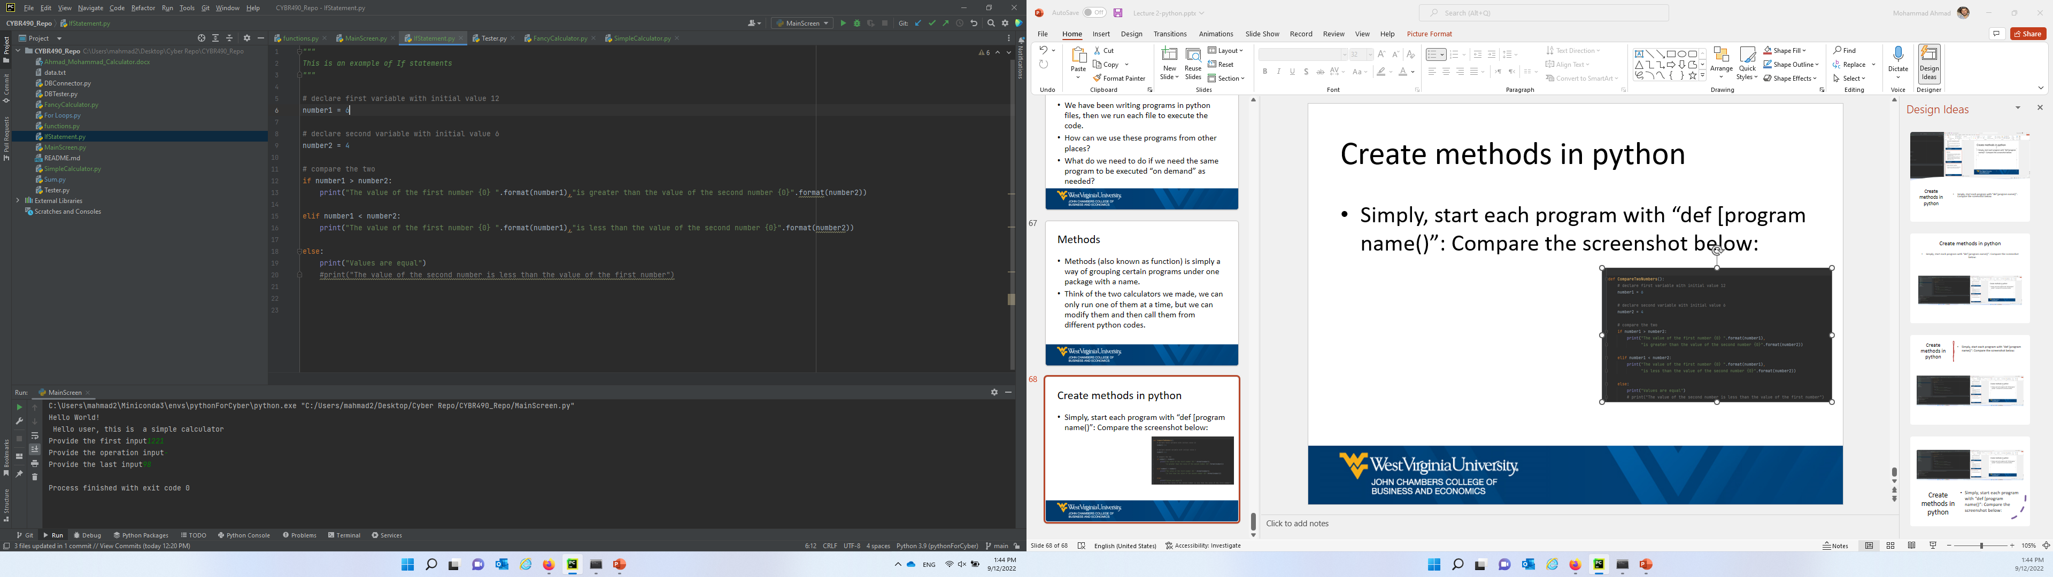
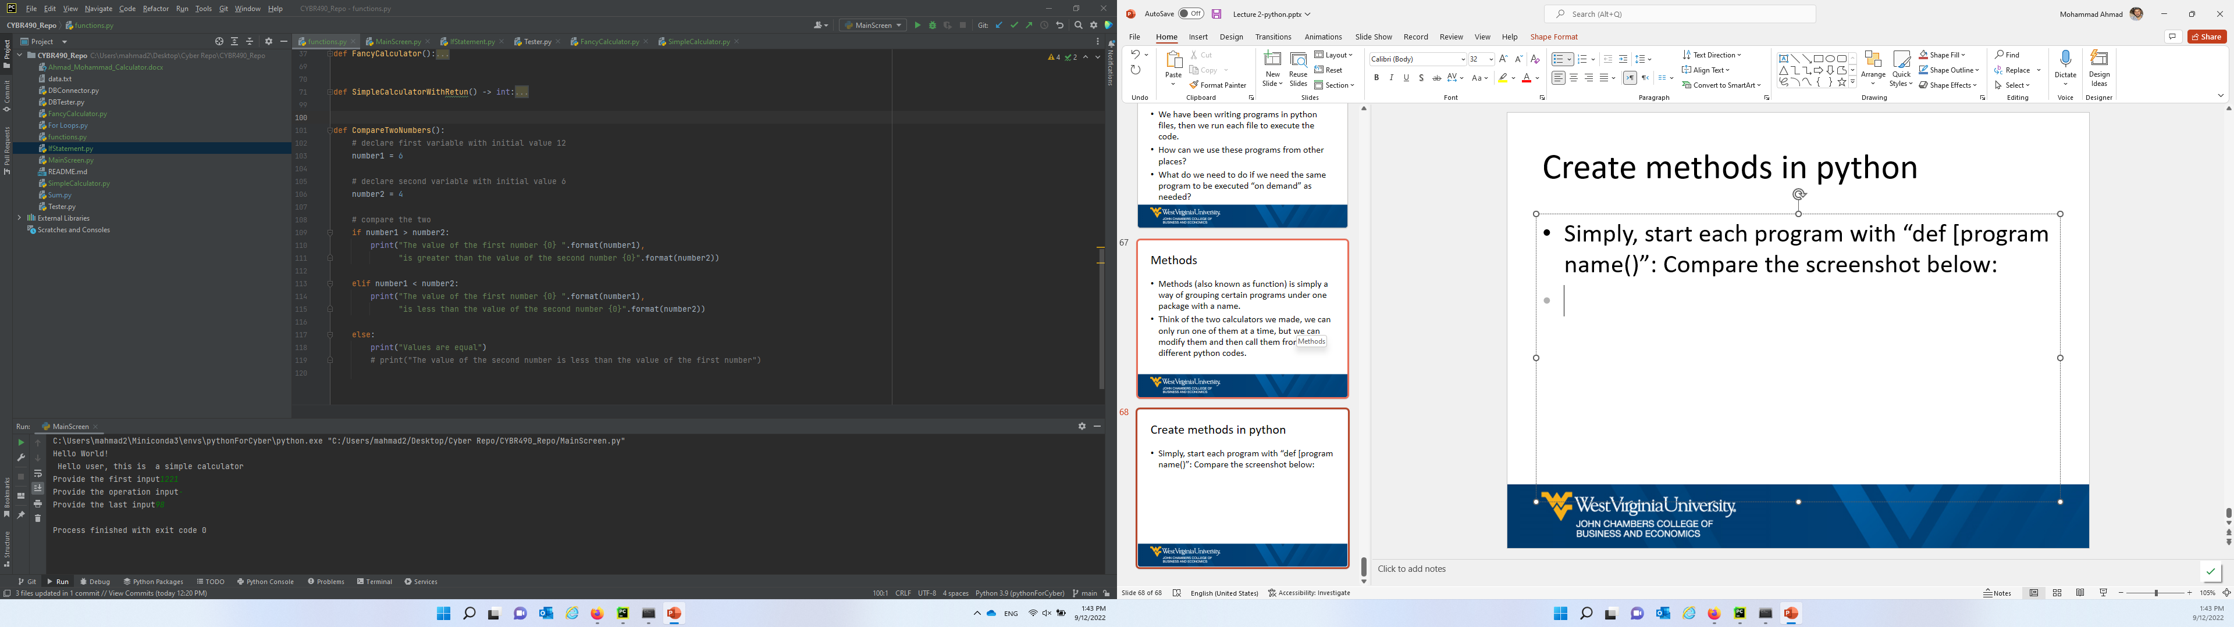
Create methods in python
Simply, start each program with “def [program name()”: Compare the screenshot below:

Slide 68
Passing data to method
Method are independent but often we need to pass data to them to work.
Think of a method named CircleArea, which calculates the area of a circle with diameter d.
The code in the method would look like code in the next slide:

Slide 69
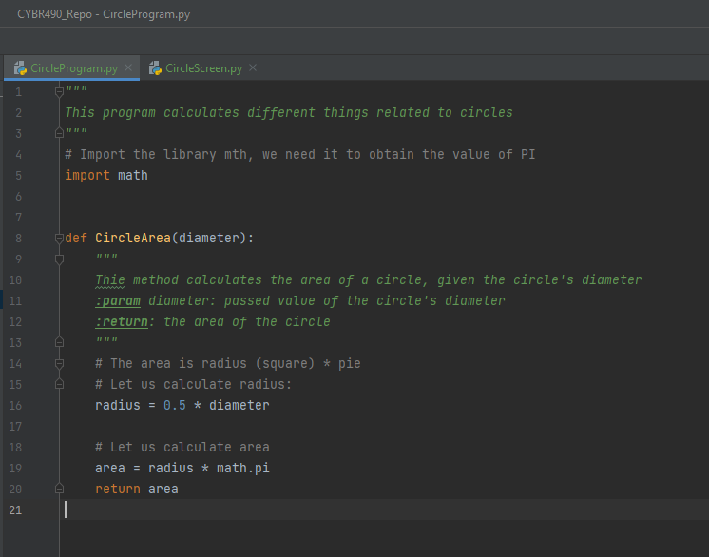
Passing data to method
A method named CircleArea, which accepts one parameter named diameter
After the area is calculated, it gets returned to where its being called from

Slide 70
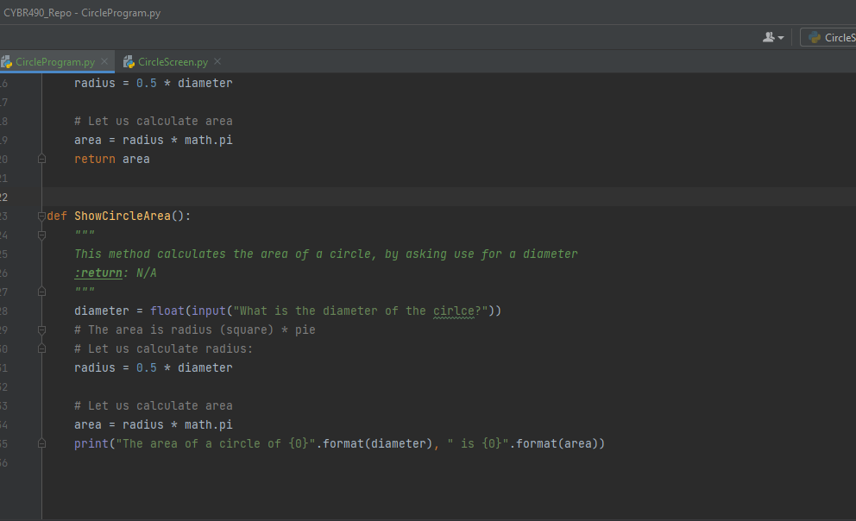
Methods without passing data
Some method may not need data passed. Meaning you may accept data inside the method itself.
A method named ShowCircleArea, which does not accept any parameters
After the area is printed out inside the method

Slide 71
Method: types
There are two types as shown before:
Return type: this method does its job and then returns a value (i.e., the result) back to where it is called from.
Non-return: This method does not return anything. In most cases, it just printouts out results, or modifies some global variables.

